Slide 1
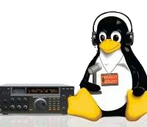
Linux
and
HAM Radio
Dave Palica
KR0OT
Notes:
Welcome

Slide 2
A bit about me
Engineering manager for Brigham Young University Office of Information Technology
KD7TZG first licensed January 2003
Linux user since 2005
On the team that researched and brought enterprise Linux to Brigham Young University
ARRL Registered License Instructor
VE with W5YI-VEC and ARRL VEC
Vanity Call Sign KR0OT to merge love of radio and Linux
Notes:
Yes, I took Steve Whiteheads Saturday class.
Failed the first test
Passed the second time.
No radio for years. Tania got me one in 2019
General
Amateur Extra the same day my oldest son Andy got his Technician license - KJ7FUJ

Slide 3
A bit about you
What do you want to get out of this class?
This is an “open-source” training. I will do my best to address topics you are interested in and answer what questions you have.

Slide 4
Why Linux?
Notes:
Open Source
Multiple "Spins" of linux (ie. Ubuntu, SUSE, Debian, Fedora, Kali, etc.)
Multiple desktops (ie. KDE, Cinnamon, gnome, mate, etc.) Yes, there are Windows and Mac look-a-likes too.
<number>

Slide 5
Why Linux?
Stop Windows Insanity!
Notes:
No or Low cost. Can purchase support contracts if you need help, but...
<number>

Slide 6
Why Linux?
Stop Windows Insanity!
Windows is an overall bad design
(package management, non-preemptive, .dll, updates, etc.)
Notes:
Package management – Windows Installer cache fills up the drive. Keeps a copy of all of the installer files on C:\windows\installer
Non-preemtive – Can starve CPU resources with poorly designed software. Preemptive gives all applications equal slice of CPUs.
.dll – keeps multiple versions of shared .dll which also fills up the drive.
Updates – C:\windows\softwaredistribution – also fills up the drive.
At the mercy of Microsoft
AND a huge target for hackers.
<number>

Slide 7
Why Linux?
Open Source
Notes:
Open Source
Multiple "Spins" of linux (ie. Ubuntu, SUSE, Debian, Fedora, Kali, etc.)
<number>

Slide 8
Why Linux?
Open Source
No / Low cost
Great community support
Notes:
There is a great open-source community. Lots of help in forums or other web sites.
If you run into a problem, chances are someone else already has had the same problem and posted a workaround or fix.
If you really need help, there are paid support options. I rarely use them because there is so much information on-line.
<number>

Slide 9
Why Linux?
Open Source
No / Low cost
Great community support
Stable
Notes:
Stable. Big vendors backing the opensource community are making many contributions. (Oracle, RedHat, SUSE, Microsoft, etc.)
<number>

Slide 10
Why Linux?
Open Source
No / Low cost
Great community support
Stable
Patch on your terms
Notes:
No forced reboots in the middle of a presentation or when you have many unsaved changes in multiple documents.
Can be scheduled to automatically patch through a CRON job.
For Example:
apt-get update
apt-get upgrade -y
apt autoremove -y
apt-get update
<number>

Slide 11
Why Linux?
Open Source
No / Low cost
Great community support
Stable
Patch on your terms
Choose your own desktop
Notes:
Xfce, gnome, cinnamon, mate, lxqt, KDE and variants, LXDE, Budgie, Enlightenment, Pantheon, sugar, trinity, cde, Lumina, UKI, UDE, Razor-qt, ROX, Ambient, Elokab, Project Looking Glass, GNUstep, EDE, Etoile, Mezzo, and others.
<number>

Slide 12
Notes:
Distro depends on what you are trying to accomplish and your hardware.
For remote operations I like the Rapsberry pi with Raspbian and for my work I like Linux Mint with Cinnamon Desktop
For Hacking/Penetration testing, Kali linux.
<number>

Slide 13
Notes:
KDE, Gnome, Cinnamon, Mate, etc.
Last I checked there were 27 to choose from.
Some are minimalistic and others are fully fledged.
<number>

Slide 14
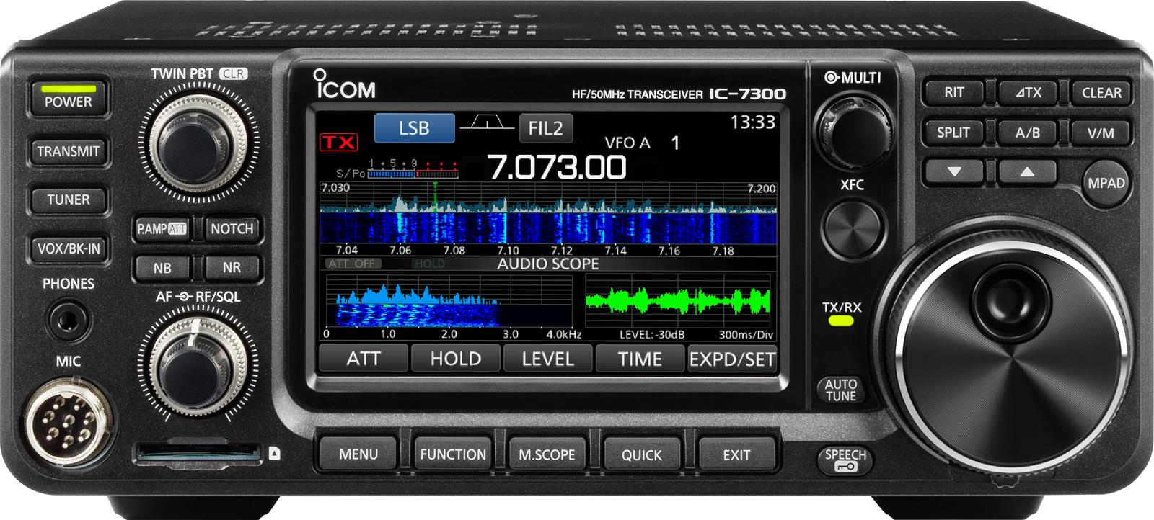
HAM Radio and Linux
Where do we start?
Notes:
So where do we start? Digital Operations!
Disclaimer, this can also be done in Windows.
<number>

Slide 15
Where to Start?
Radio Control
FLRIG
Notes:
FLRIG by W1HKJ and associates is based on Linux LIBHAM libraries.
Provides control of radio through a GUI interface
Can be used for remote digital operations (ie with a Raspberry Pi and VNC – I use realvnc)
Interfaces with multiple radio applications which we will look at in a few minutes
<number>

Slide 16
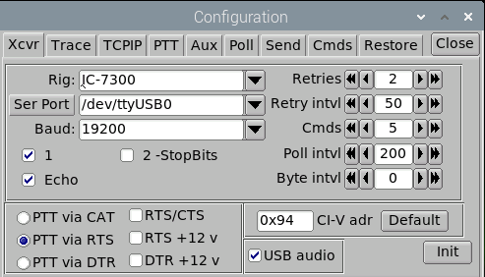
Where to Start?
Radio Control
FLRIG
Notes:
Setup is the same as each individual application
Rig, Port, Rate, PTT, CI-V address, etc.
Make sure user is a member of the dialout group
In engineering we like to engineer once, use many times.
<number>

Slide 17
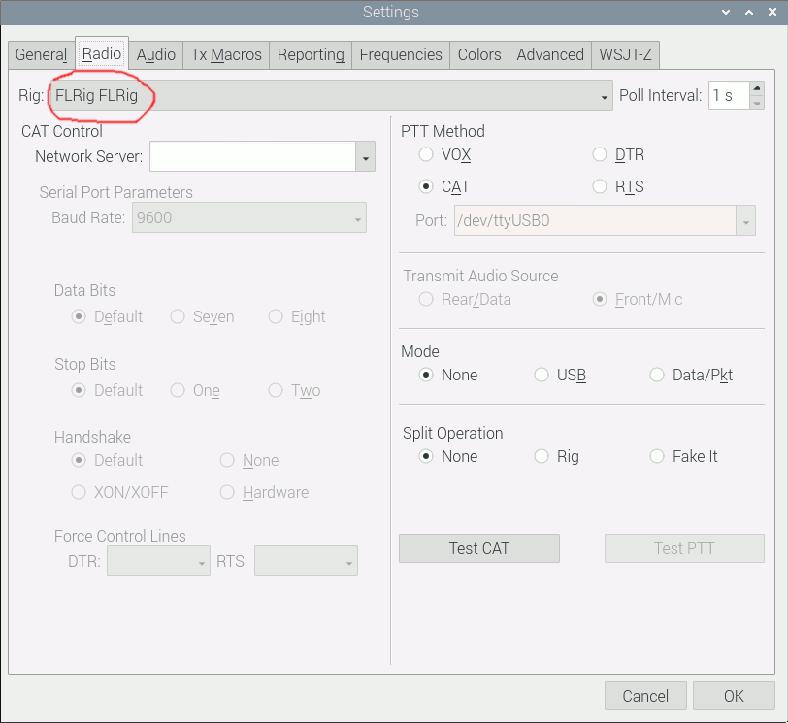
Where to Start?
Radio Control
FLRIG
WSJT-X
Notes:
WSJT-X Written by Joe Taylor allows use of many different modes. One of the most popular is FT-8
Select "FLRig FLRig" and your audio input/output and your configuration is done. There are grayed-out settings because they are already configured in FLRIG
<number>

Slide 18
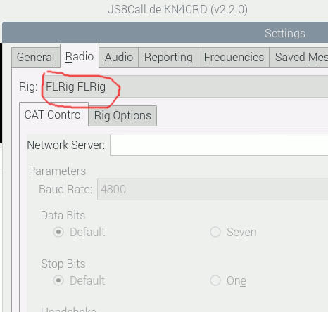
Where to Start?
Radio Control
FLRIG
WSJT-X
JS8CALL
Notes:
Js8call is the same. Select FLRig FLRig and the audio input and output. Notice how the rest of the items are grayed out.
<number>

Slide 19
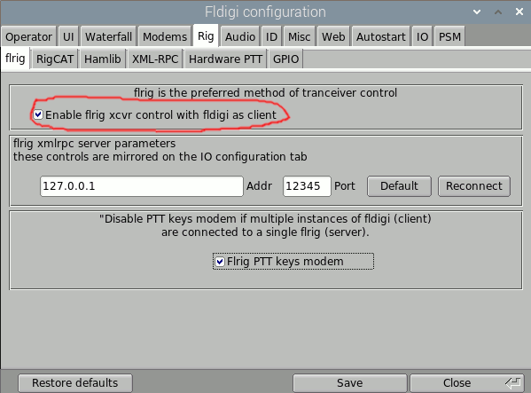
Where to Start?
Radio Control
FLRIG
WSJT-X
JS8Call
FLDIGI
Notes:
FLDIGI is easier. Just check the box and select the capture and playback audio channels.
<number>

Slide 20
What's next?
Logging
Which one do I use?
Notes:
There are numerous linux logging clients.
How about automatic logging for digital modes?
<number>

Slide 21
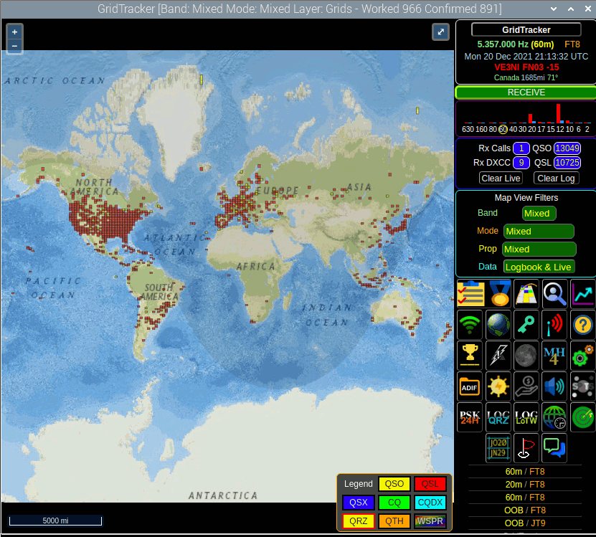
What's next?
Logging
Which one do I use?
GridTracker
Notes:
GridTracker. Wait? GridTracker for logging?
Sure!
<number>

Slide 22
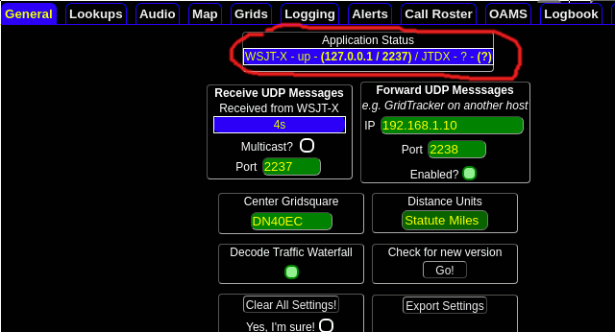
What's next?
Logging
Which one do I use?
GridTracker
Notes:
Select the gear icon for settings and look at the General Tab. You can see that WSJT- is connected.
Notice the "Receive UDP Messages Port is 2237".
<number>

Slide 23
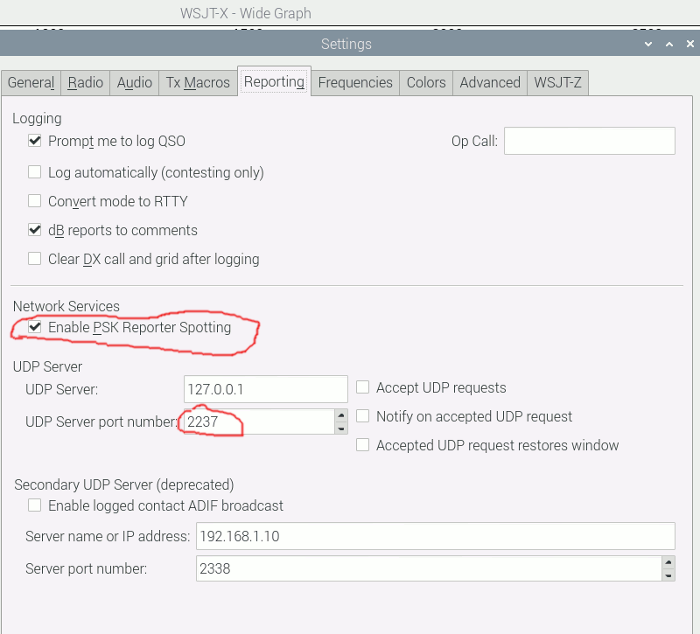
What's next?
Logging
Which one do I use?
GridTracker
Notes:
Select the gear icon for settings and look at the General Tab. You can see that WSJT- is connected.
Notice the "Receive UDP Messages Port is 2237". This forwards the "logged contacts" from WSJTX to GridTracker. If you want to forward
<number>

Slide 24
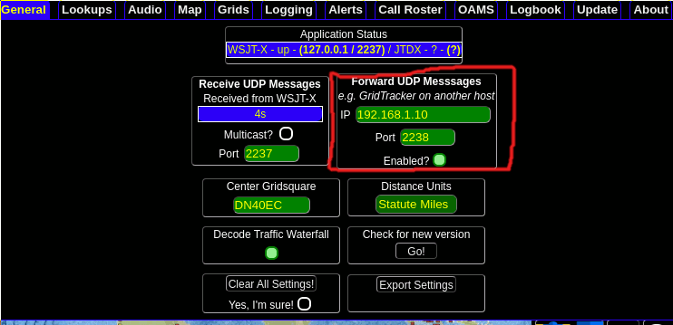
What's next?
Logging
Which one do I use?
GridTracker
Notes:
One thing I like to do is forward it from my Raspberry Pi to my laptop where I have more screen real-estate.
<number>

Slide 25
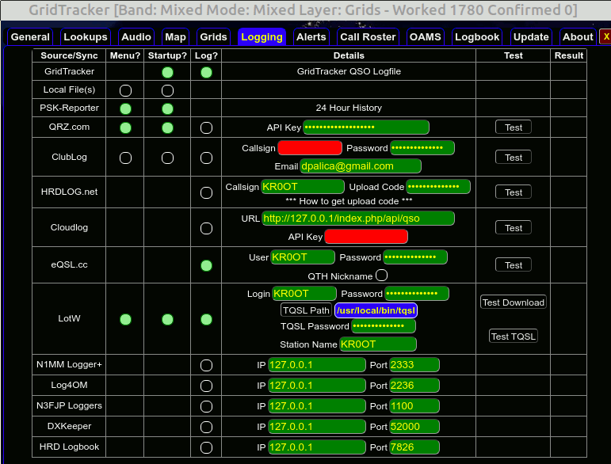
What's next?
Logging
Which app do I use?
GridTracker
Notes:
Here's where you actually configure your logbooks. You can configure multiple.
<number>

Slide 26
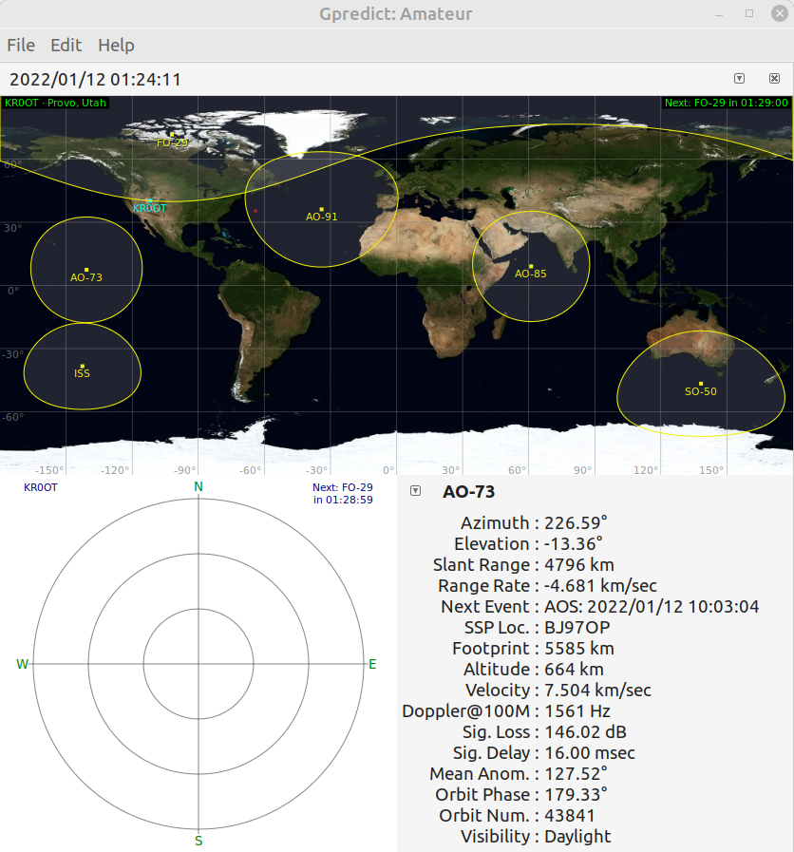
What's next?
Logging
Which app do I use?
GridTracker
Satellite (gpredict)
Notes:
Gpredict is a satellite tracking application. Want to know when the ISS is on your horizon?
<number>

Slide 27
What's next?
Logging
Which app do I use?
GridTracker
Satellite
Remote Operation
Notes:
Remote operation
FCC Part 97.2213
<number>

Slide 28
Remote Operation
FCC Part 97.213 Remote Control Timeout
§97.213 Telecommand of an amateur station.
An amateur station on or within 50 km of the Earthâ€™s surface may be under telecommand where:
(a) There is a radio or wireline control link between the control point and the station sufficient for the control operator to perform his/her duties. If radio, the control link must use an auxiliary station. A control link using a fiber optic cable or another telecommunication service is considered wireline.
(b) Provisions are incorporated to limit transmission by the station to a period of no more than 3 minutes in the event of malfunction in the control link.
(c) The station is protected against making, willfully or negligently, unauthorized transmissions.
(d) A photocopy of the station license and a label with the name, address, and telephone number of the station licensee and at least one designated control operator is posted in a conspicuous place at the station location.
Notes:
I accomplish this with a CRON job. If my internet connection (ie. Control linnk) goes down, so does the power to my radio.
*/1 * * * * /usr/local/bin/failsafe >>/home/pi/failsafe.log
<number>

Slide 29
#! /bin/bash
function check {
# if we don't have a file, start at zero
if [ $? -ne 0 ] ; then
if [ ! -f "/tmp/value.dat" ] ; then
value=0
# otherwise read the value from the file
else
value=`cat /tmp/value.dat`
fi
# increment the value
value=`expr ${value} + 1`
#logger "Failsafe value triggered count"
# show it to the user
printf '%s %s ' "$(date)"
echo "value: ${value}"
# and save it for next time
echo $value
printf '%s %s' "Failsafe warning #" + $value
echo "${value}" > /tmp/value.dat
max=3
if [ "$value" -gt "$max" ]; then
printf '%s %s ' "$(date)"
printf '%s %s' "Failsafe activated - no network avaiable. Powering off ICOM 3700"
python /usr/local/bin/poweroff.py
fi
else
#logger "Failsafe - Network available at sfcn.org"
#printf '%s %s ' "$(date)"
#echo "Network is up"
value=0
echo "${value}" > /tmp/value.dat
exit 0
fi
}
curl -s -o "/dev/null" sfcn.org
check;

Slide 30
Remote Operation
My Setup:
Raspberry Pi 4
Cost is up due to chip supply shortage
Currently $55 for 4GB model
Raspbian OS
Network connection
USB to ICOM 7300
Notes:
Here's where you actually configure your logbooks. You can configure multiple.
<number>

Slide 31
Remote Operation (continued)
My Setup:
VNC Server
CRON job to turn off radio of network is lost.
Wyze plug for remote radio power operations
Notes:
<number>

Slide 32
What's next?
Logging
Which app do I use?
GridTracker
Satellite
Remote Operation
And many others. Please Explore!
Notes:
Remote operation
FCC Part 97.2213
DudeStar – Digital voice operations DMR/Yaesu Fusion/Dstar, M17,P25, NXDN and no radio required.
QTEL – EchoLink client and no radio required
CHIRP – Program radios
<number>

Slide 33
Questions?
Notes:
<number>

Slide 34
How to contact me
KR0OT@byu.edu
UVARC Slack
And if you hear me on the radio!

Slide 35
Additional Resources
Or how to Linux Ham like a Ninja
http://www.arrl.org/ubuntu-linux-for-hams
https://sourceforge.net/projects/kb1oiq-andysham/
https://www.dxzone.com/catalog/Software/Linux/
https://www.youtube.com/results?search_query=linux+ham+radio
Notes:
1. ARRL has a great resource about linux
2. Andy Stewart KB1OIQ has a linux (Ubuntu based) live image you can download (Last updated 10/21)
3. DX Zone has a pretty comprehensive list of software for linux.
4. Youtube has many good videos on Linux and Ham Radio

Slide 36
How to contact me
KR0OT@byu.edu
UVARC Slack
And if you hear me on the radio!

Slide 37
How to contact me
KR0OT@byu.edu
UVARC Slack
And if you hear me on the radio!

