Slide 1

WINLINK - LAB
Dave Palica
KR0OT
Notes:
Welcome

Slide 2

A bit about me
Engineering manager for Brigham Young University Office of Information Technology
KD7TZG first licensed January 2003
Linux user since 2005
On the team that researched and brought enterprise Linux to Brigham Young University
ARRL Registered License Instructor
VE with W5YI-VEC and ARRL VEC
Vanity Call Sign KR0OT to merge love of radio and Linux
Notes:
Yes, I took Steve Whiteheads Saturday class.
Failed the first test
Passed the second time and received the call KD7TZG.
No radio for years. Tania got me one in 2019
General
Amateur Extra the same day my oldest son Andy got his Technician license - KJ7FUJ

Slide 3

A bit about you
What do you want to get out of this class?
This is an “open-source” training. I will do my best to address topics you are interested in and answer what questions you have.
Notes:
This course is to help you get up and running on WINLINK. Although WINLINK is great for emergency communications it is beyond the scope of this course.

Slide 4
What is WINLINK?
Notes:
<number>

Slide 5
What is WINLINK?
WINLINK Global Radio Email®️is a network of amateur radio and authorized government stations that provide worldwide radio email using radio pathways where the internet is not present.
Notes:
Winlink Global Radio Email®️...
...is a network of amateur radio and authorized government stations that provide worldwide radio email using radio pathways where the internet is not present.
<number>

Slide 6
What is WINLINK?
The system is built, operated and administered entirely by licensed "Ham" volunteers. It supports email with attachments, position reporting, weather and information bulletins, and is well-known for its role in interoperable emergency and disaster relief communications. It is capable of operating completely without the internet--automatically--using smart-network radio relays. Licensed Winlink operators/stations use both amateur radio and government radio frequencies worldwide.
Notes:
The system is built, operated and administered entirely by licensed "Ham" volunteers. It supports email with attachments, position reporting, weather and information bulletins, and is well-known for its role in interoperable emergency and disaster relief communications. It is capable of operating completely without the internet--automatically--using smart-network radio relays. Licensed Winlink operators/stations use both amateur radio and government radio frequencies worldwide. Support for the system is provided by the Amateur Radio Safety Foundation, Inc., a US 501(c)(3) non-profit, public-benefit entity. Winlink Global Radio Email®️ is a US registered trademark of the Amateur Radio Safety Foundation, Inc.
<number>

Slide 7
How do I start?
Notes:
How do I start?
<number>

Slide 8
How do I start?
Get a WINLINK account
Install a client
Install a transport (optional)
Notes:
Get a WINLINK account
Install a client
Install a transport
<number>

Slide 9
Get a WINLINK Account
https://winlink.org
Notes:
Go to https://winlink.org
Select “My Account” on the top-left of the toolbar. This will give you instructions on how to download the client and create the account.
This is also the page you use if you forgot your password.
You can also view your webmail from here. https://webmail.winlink.org:446/
<number>

Slide 10
How do I start?
Get a WINLINK account
Install a client
Install a transport (optional)
Notes:
Get a WINLINK account
Install a client
Install a transport
<number>

Slide 11
Install a Client
https://downloads.winlink.org
Go to “User Programs”
Select “Winlink_Express_install” current version.
https://winlink.org/ClientSoftware for a full list of clients and protocols
Notes:
https://downloads.winlink.org
Full list of clients and protocols at https://winlink.org/ClientSoftware
<number>

Slide 12
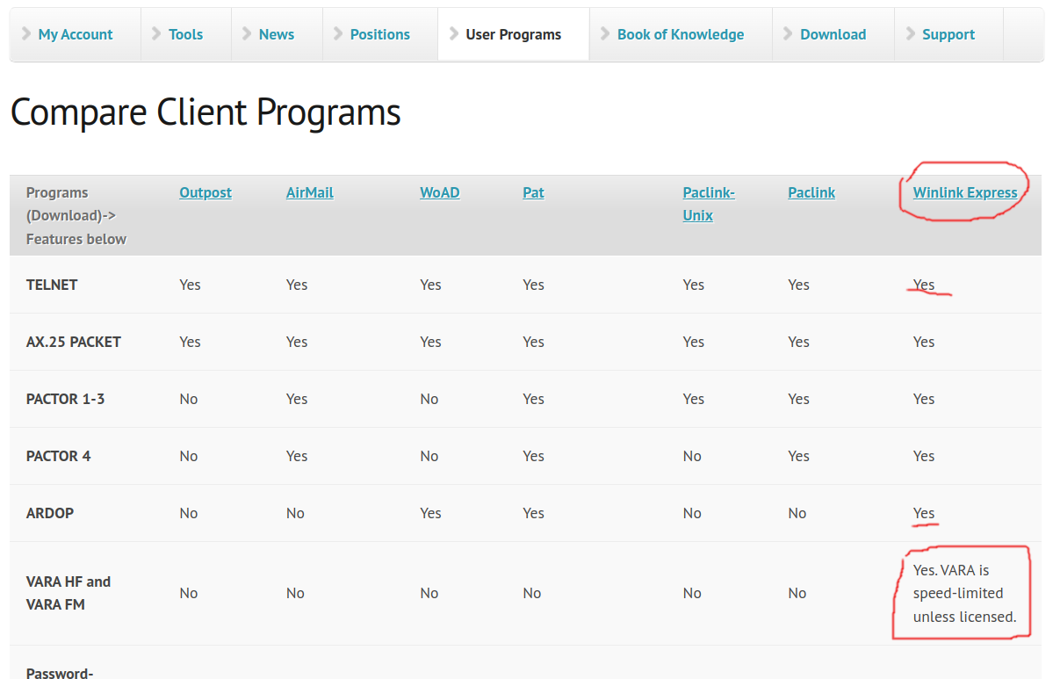
Install a Client
Notes:
Point out a few items:
You don’t have to have a radio to use WINLINK. It supports the TELNET protocol.
I’ve also used the ARDOP and VARA HF protocols. I licensed the VARA protocols because when licensed they implement data compression. This allows shorter transmit times on the radio.
Linux options are PAT and Paclink-Unix. I’ve had PAT working on a raspberry pi but it is feels a bit clunky.
KM4ACK has a set of four youtube tutorials on how to set up PAT Winlink.
<number>

Slide 13
Install a Client
DEMO – Winlink Express
Notes:
Create a WINLINK account
Download Client
Run the client in windows
Send a message to the students in the class with tcp/ip
<number>

Slide 14

Install a Client
But what about Linux?
Notes:
There are applications and protocols that support linux too.
<number>

Slide 15
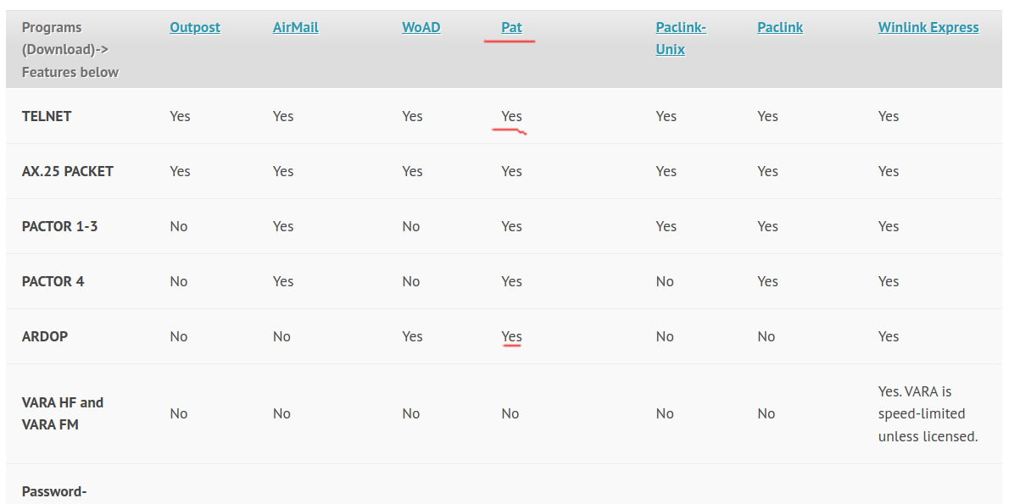
Install a Client
Notes:
Point out a few items:
Linux options are PAT and Paclink-Unix. I’ve had PAT working on a linux and a raspberry pi but it is feels a bit clunky.
KM4ACK has a set of four youtube tutorials on how to set up PAT Winlink on Raspbian.
Paclink-unix must be compiled from source and is beyond the scope of this class.
<number>

Slide 16
Install a Client
DEMO – PAT
Notes:
1. Set up editor
echo 'export EDITOR=nano' >> ~/.profile
source ~/.profile
2. pat configure
3. Configure protocols (ardop) optional
4. pat compose – FROM: KR0OT@WINLINK.ORG
5. ~/.local/share/pat/mailbox/YOURCALL/out
6. pat connect telnet
7. GUI: pat http – then web to port 5000
8. Connect to telnet protocol and send.
<number>

Slide 17
Install a Client
{
"mycall": "KR0OT",
"secure_login_password": "<Password goes here>",
"auxiliary_addresses": [],
"locator": "DN40ec",
"service_codes": [
"PUBLIC"
],
"http_addr": "0.0.0.0:5000",
"motd": [
"Open source Winlink client - getpat.io"
],
"connect_aliases": {
"telnet": "telnet://{mycall}:CMSTelnet@cms.winlink.org:8772/wl2k"
},
"listen": [],
"hamlib_rigs": {},
Notes:
Here’s an example of the config.json file for pat
<number>

Slide 18
Install a Client
"ardop": {
"addr": "localhost:8515",
"arq_bandwidth": {
"Forced": false,
"Max": 500
},
"rig": "<your rig here> I use 4 for flrig",
"ptt_ctrl": false,
"beacon_interval": 0,
"cwid_enabled": true
},
"pactor": {
"path": "/dev/ttyUSB0",
"baudrate": 57600,
"rig": "",
"custom_init_script": ""
},
….
Notes:
config.json continued showing protocols.
arecord -l (The “L” lists audi devices) show output with connected radio
Then run ./ardopc_64 8515 plughw:1,0 plughw1,0
<number>

Slide 19
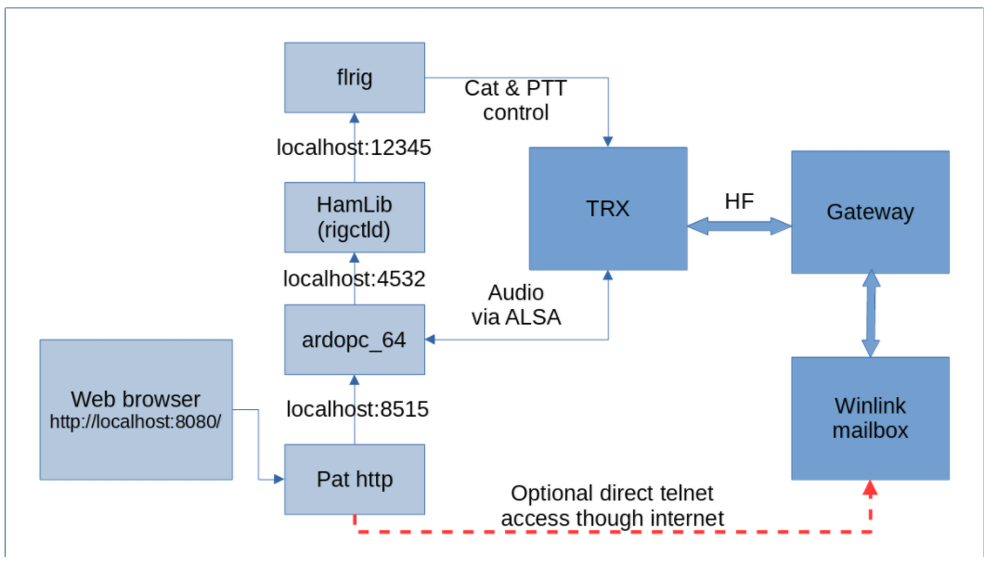
How does it work?
Notes:
Here is a map of how all of this works together
<number>

Slide 20
Use up-to-date apps
FLRIG 1.4.4
  ./configure
    Depends on FLTK 1.3.8 (sudo apt-get install libfltk1.3-dev)
  Make
    Depends on libudev-dev (sudo apt-get install libudev-dev)
  sudo make install
Notes:
config.json continued showing protocols.
arecord -l (The “L” lists audi devices) show output with connected radio
Then run ./ardopc_64 8515 plughw:1,0 plughw1,0
<number>

Slide 21
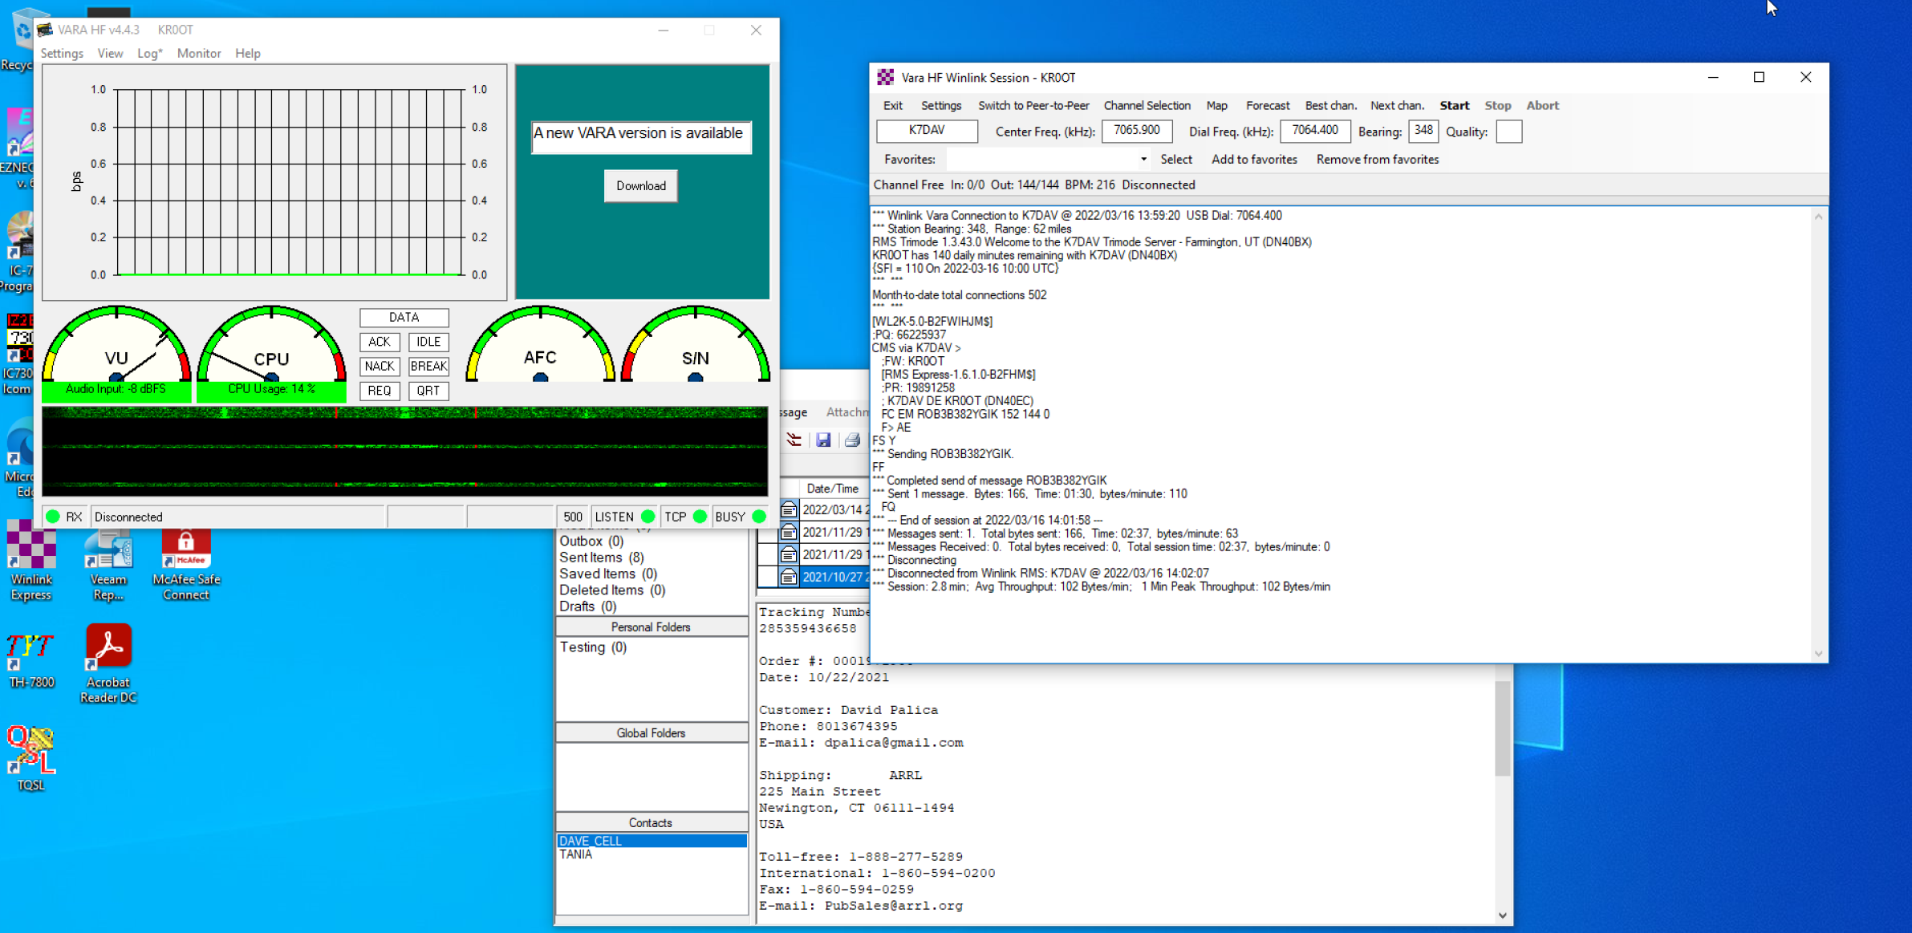
Notes:
config.json continued showing protocols.
arecord -l (The “L” lists audi devices) show output with connected radio
Then run ./ardopc_64 8515 plughw:1,0 plughw1,0
<number>

Slide 22

Questions?
Notes:
<number>

Slide 23

How to contact me
KR0OT@byu.edu
UVARC Slack
And if you hear me on the radio!

Slide 24

Additional Resources
Or how to WINLINK like a Ninja
https://winlink.org/
https://www.youtube.com/results?search_query=winlink
K4REF videos are especially useful.
http://www.w1hkj.com/
W1HKJ & Associates – Makers of FLRIG, FLDIGI, etc.
Notes:
1. https://winlink.org
2. Andy Stewart KB1OIQ has a linux (Ubuntu based) live image you can download (Last updated 10/21)
3. DX Zone has a pretty comprehensive list of software for linux.
4. Youtube has many good videos on WINLINK, especially K4REF

